Slide 1
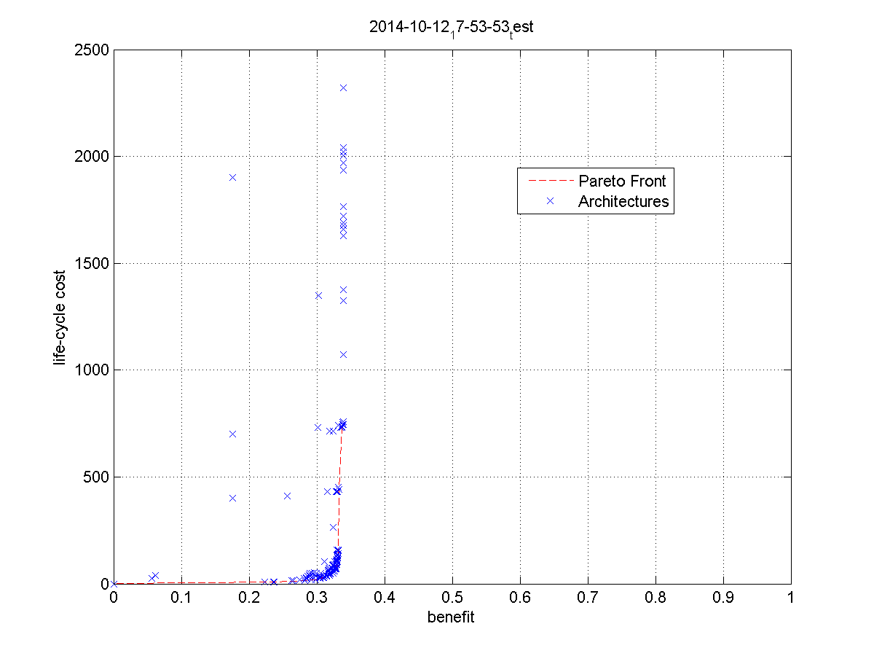
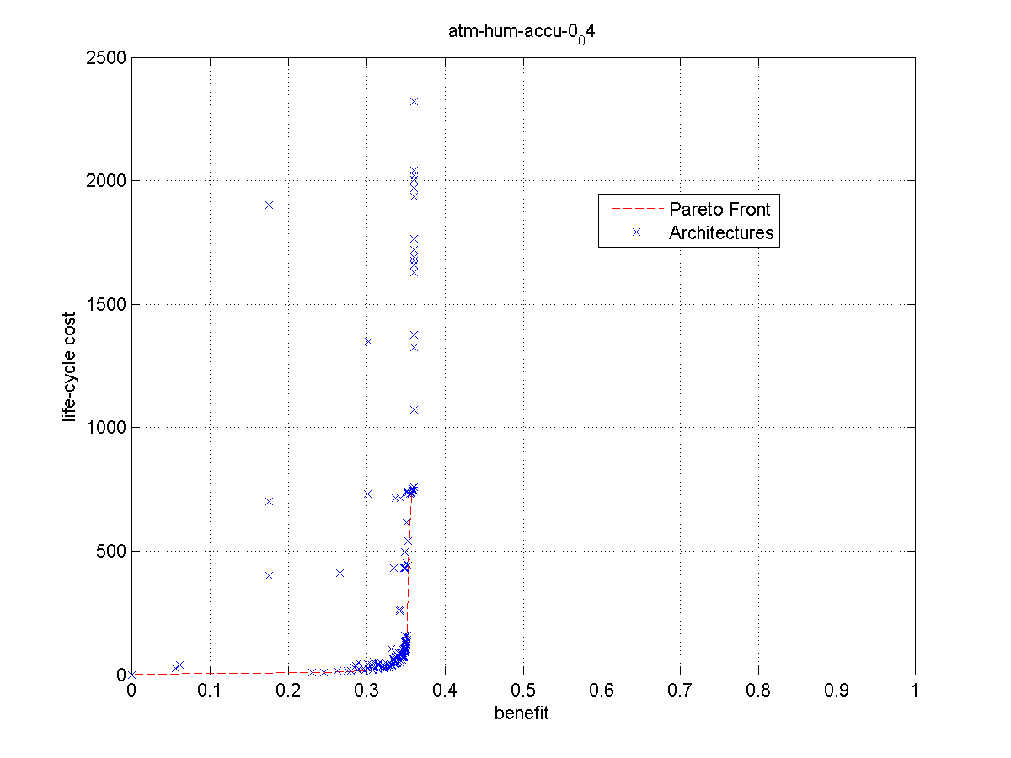

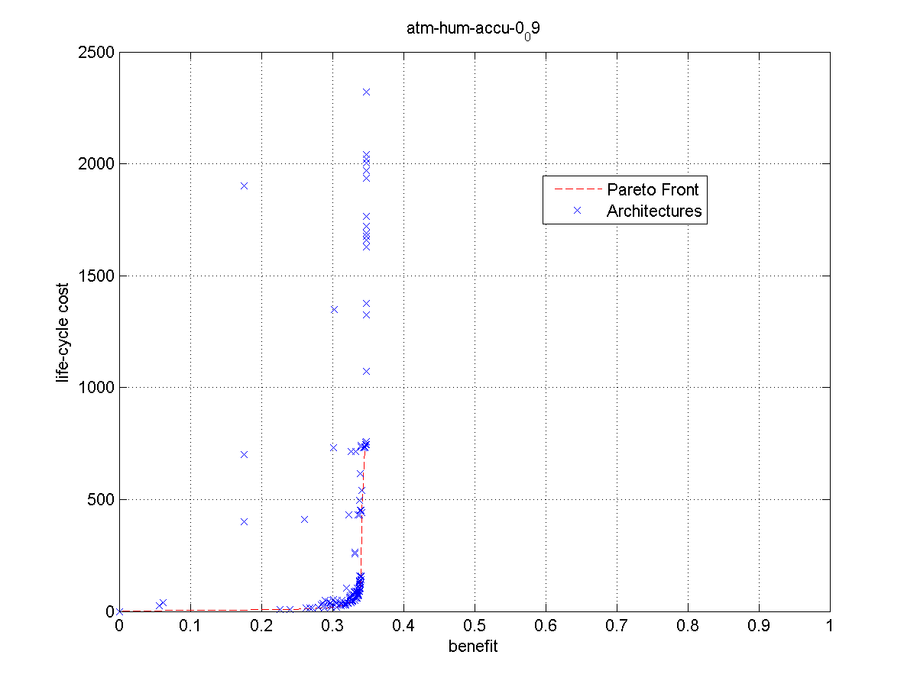
Atmospheric Humidity:
Accuracy 0.19
Atmospheric Humidity:
Accuracy 0.9
Atmospheric Humidity:
Accuracy 0.4
Atmospheric Humidity:
Accuracy 2.5

Slide 2
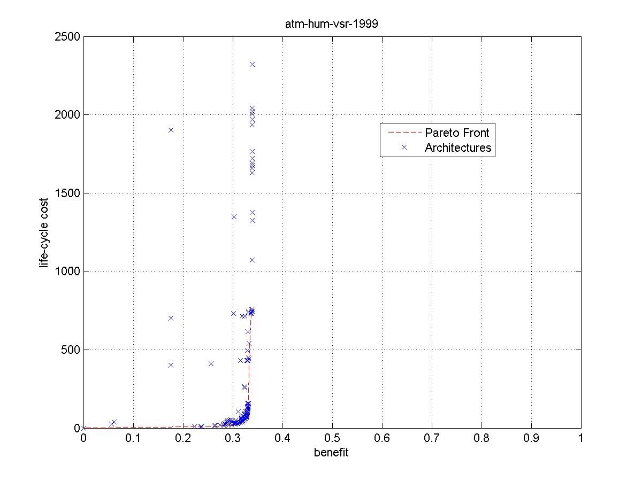
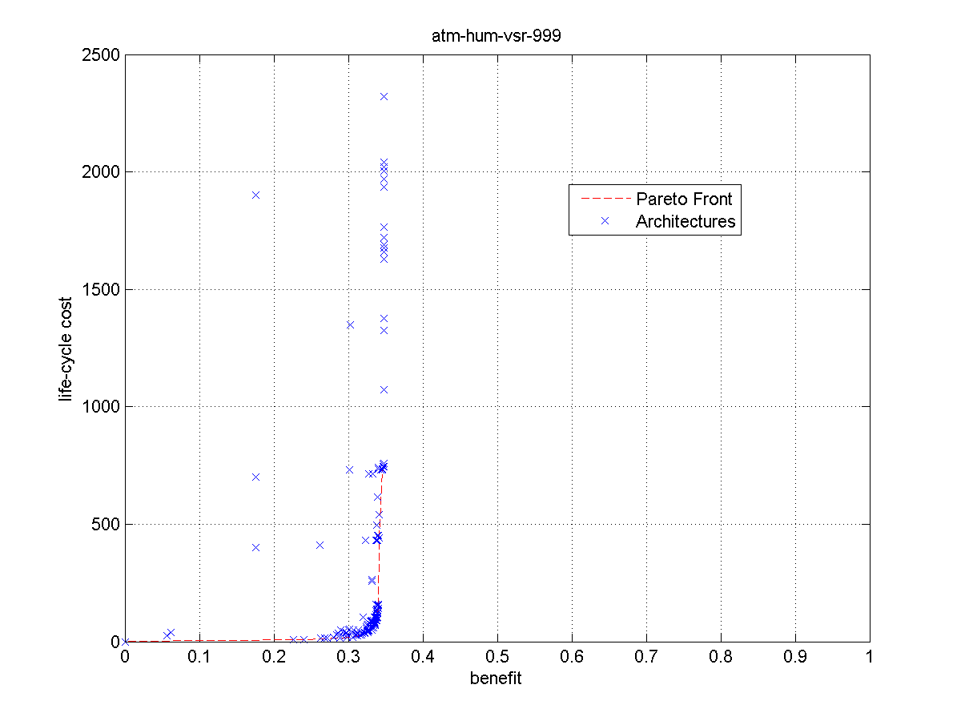





Atmospheric Humidity:
VSR 149
Atmospheric Humidity:
VSR 999
Atmospheric Humidity:
VSR 499
Atmospheric Humidity:
VSR 2000
Atmospheric Humidity:
VSR 199
Atmospheric Humidity:
VSR 1999
Atmospheric Humidity:
VSR 299
Atmospheric Humidity:
VSR 99

Slide 3
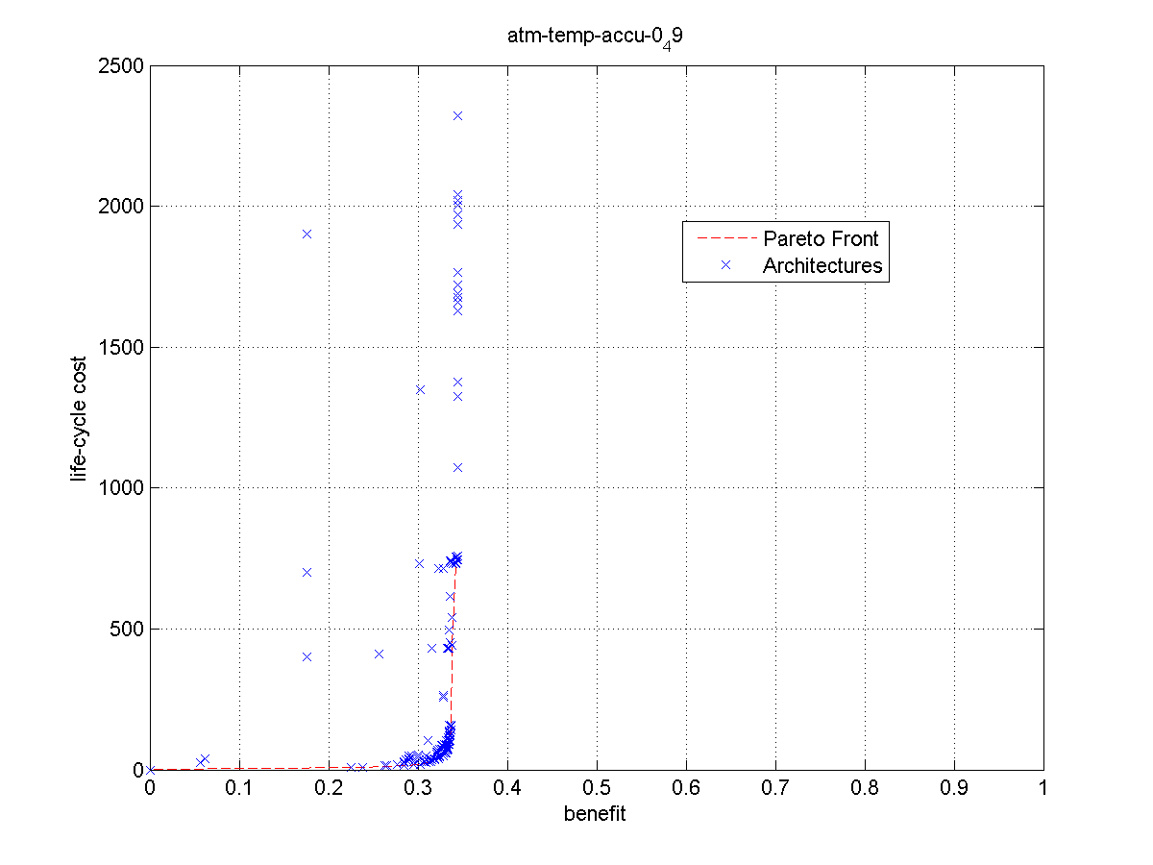
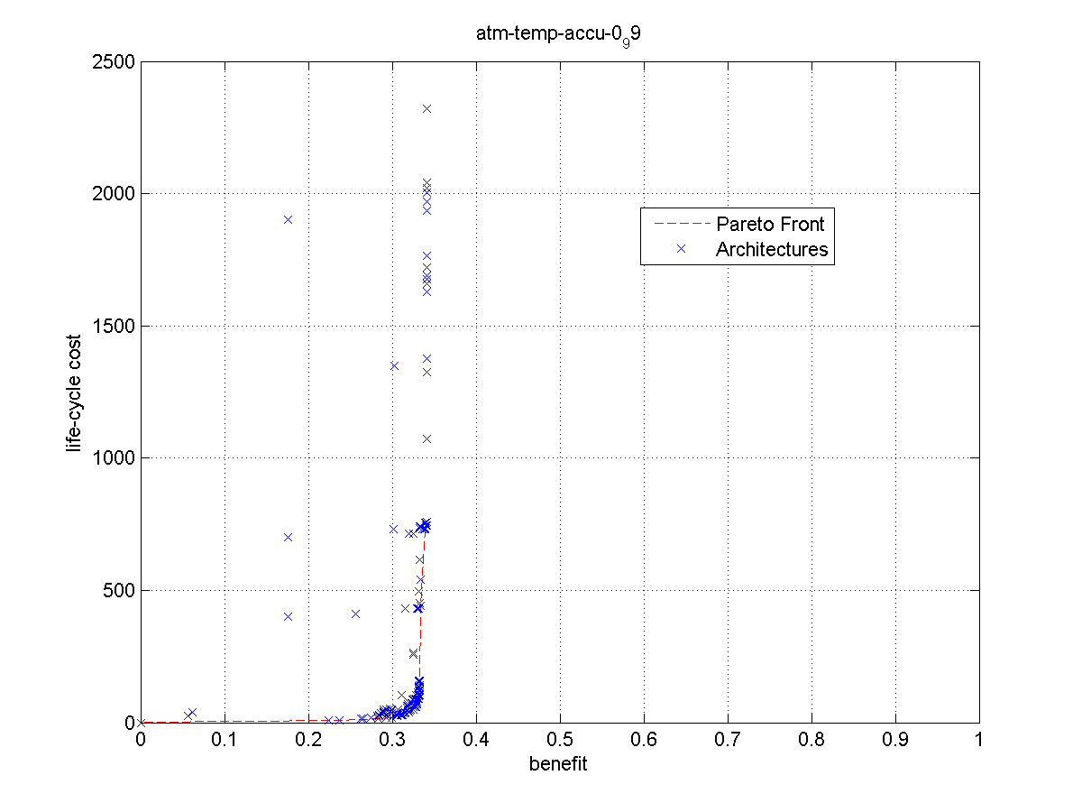

Atmospheric Temperature:
Accuracy 1.25
Atmospheric Temperature:
Accuracy 0.19
Atmospheric Temperature:
Accuracy 0.49
Atmospheric Temperature:
Accuracy 0.99

Slide 4



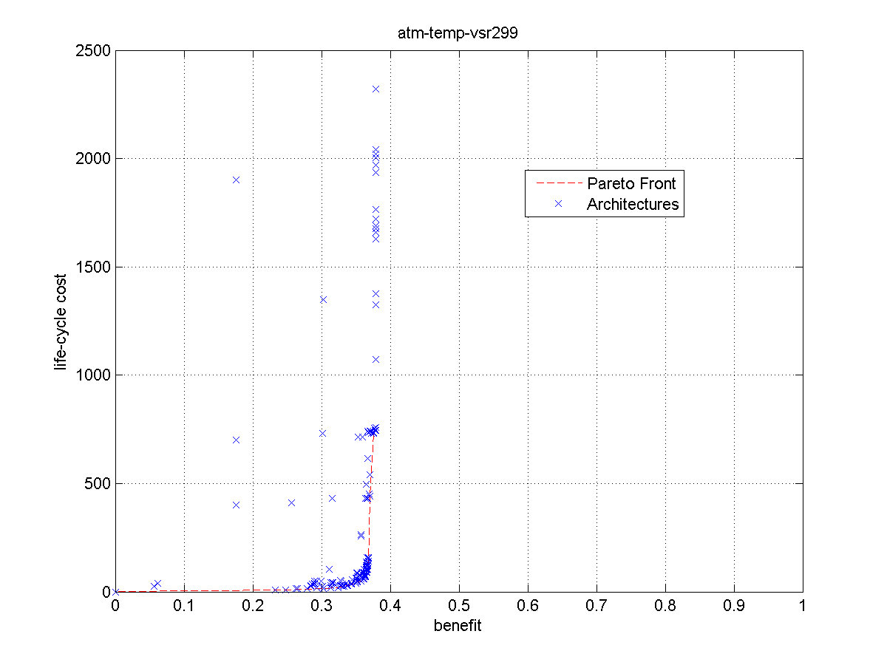
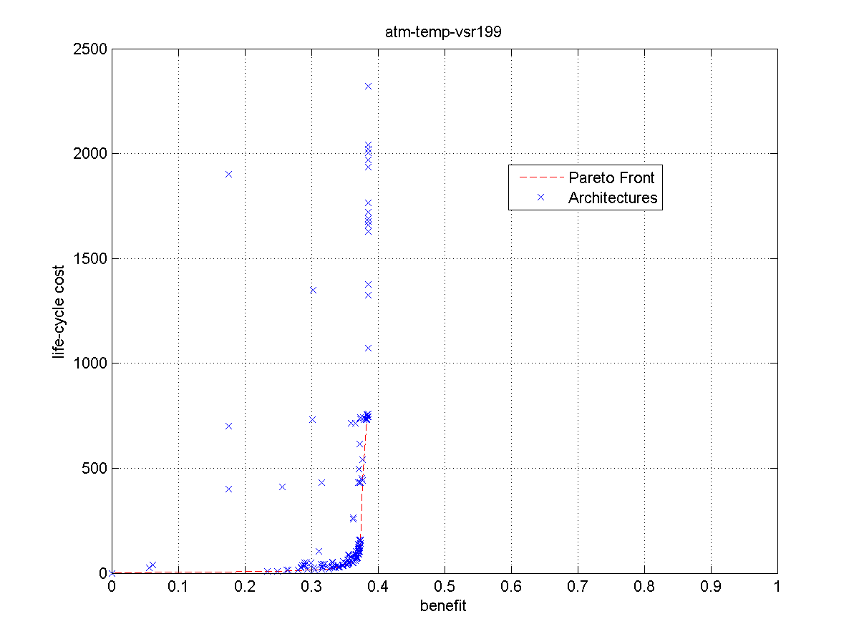
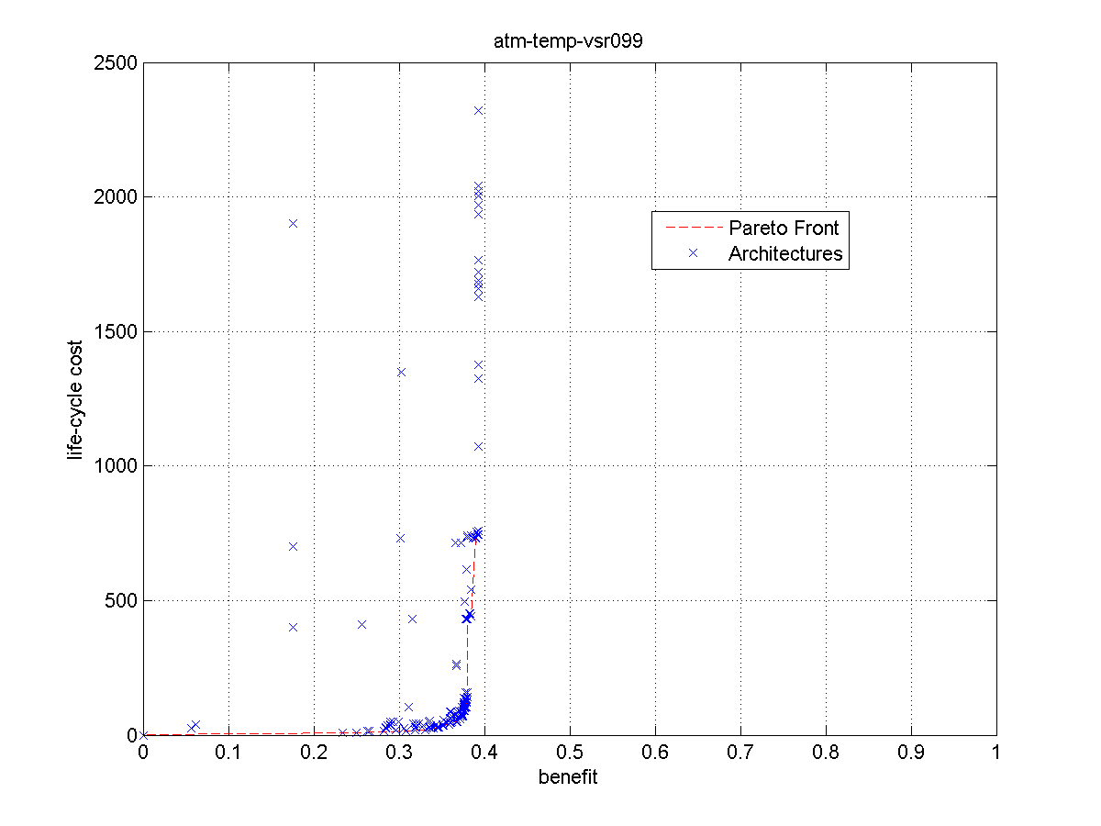
Atmospheric Temperature:
VSR 999
Atmospheric Temperature:
VSR 599
Atmospheric Temperature:
VSR 499
Atmospheric Temperature:
VSR 299
Atmospheric Temperature:
VSR 199
Atmospheric Temperature:
VSR 99
Atmospheric Temperature:
VSR 2000

Slide 5
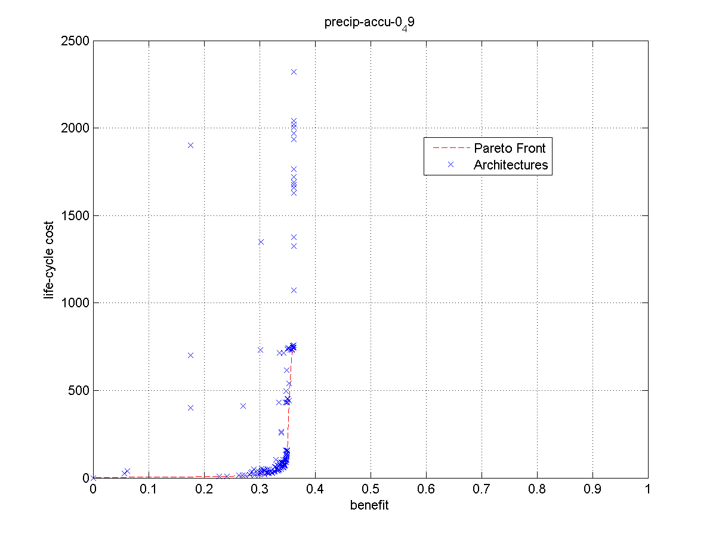

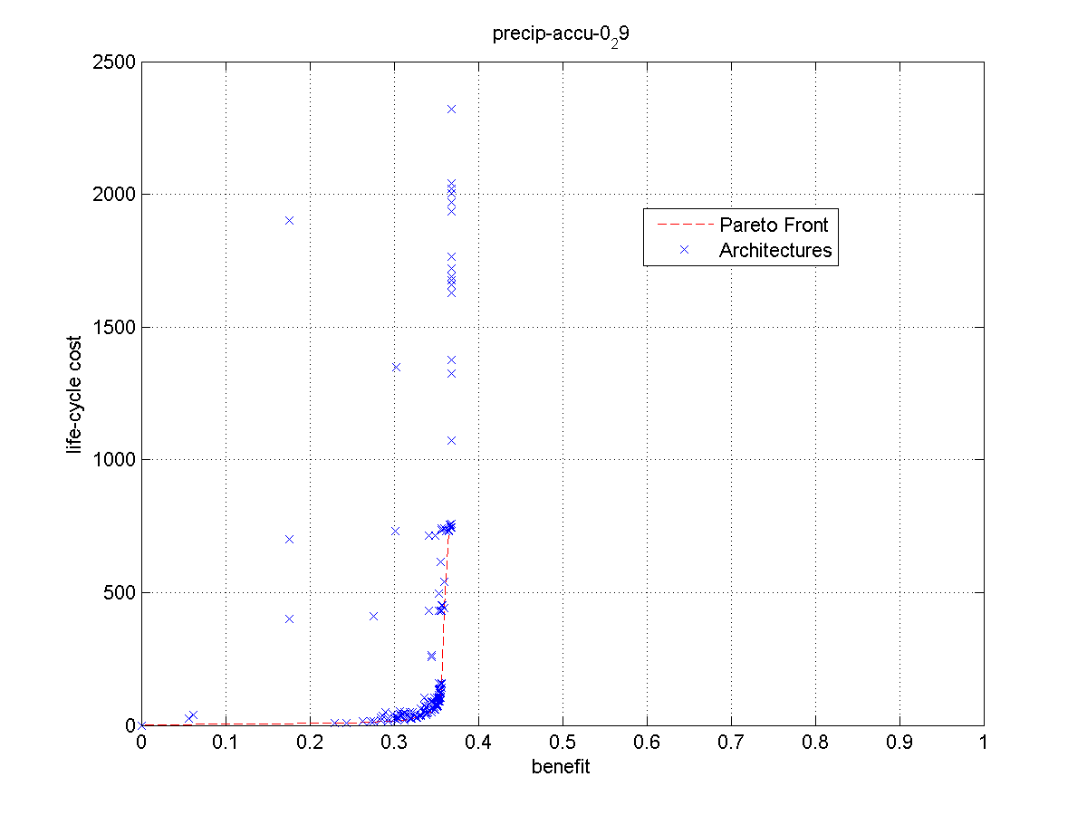

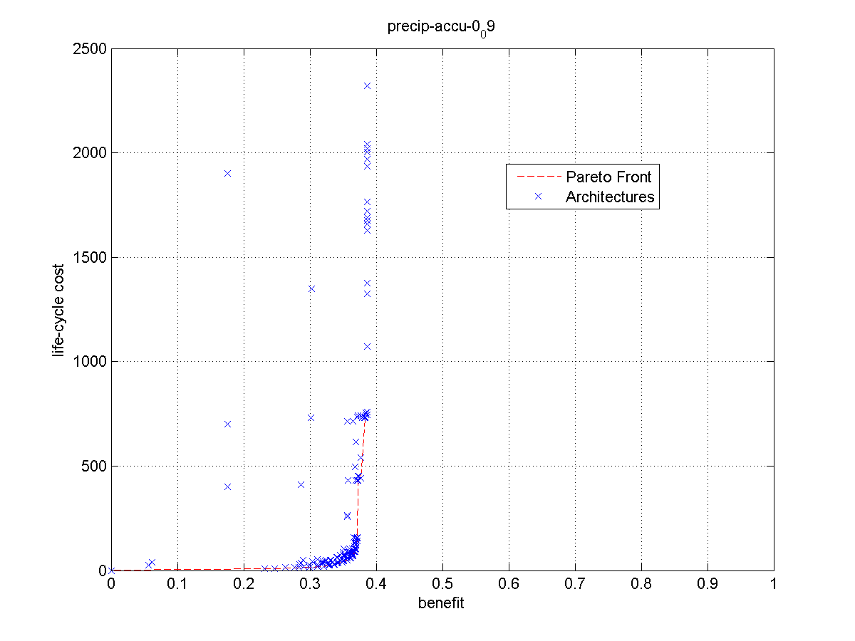
Precipitation Rate at Surface
Accuracy 0.09
Precipitation Rate at Surface
Accuracy 0.19
Precipitation Rate at Surface
Accuracy 0.29
Precipitation Rate at Surface
Accuracy 0.49
Precipitation Rate at Surface
Accuracy 1.4
Precipitation Rate at Surface
Accuracy 0.9

Slide 6
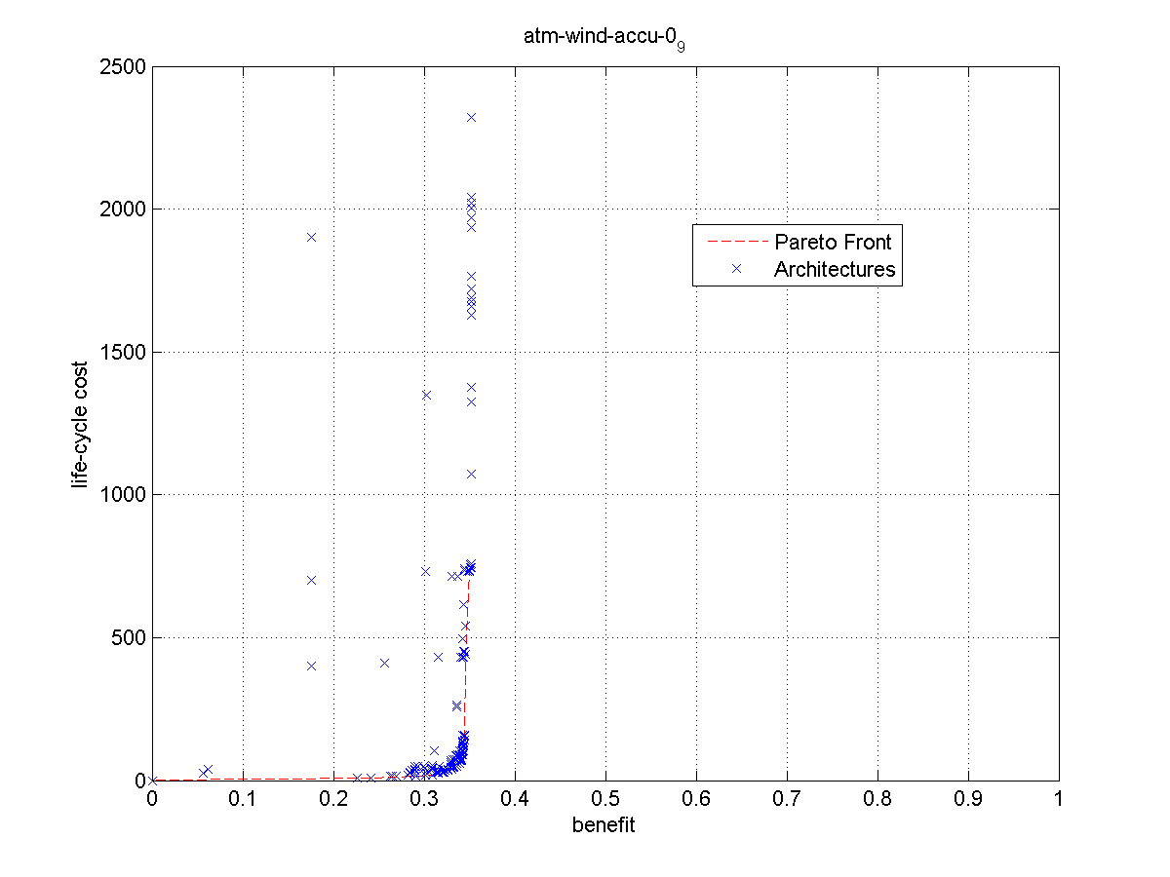


Slide 7


